Slide 1


Industrial Equipment Failure Prediction Using Edge Analytics
ML approach using Isolation Forest & Linear Regression
Course: Major Project | MCA – AI/ML
Student Name: Smarth Salaria
Student UID: O24MCA112144
Mentor Name: Vikas Kumar Atray

Slide 2


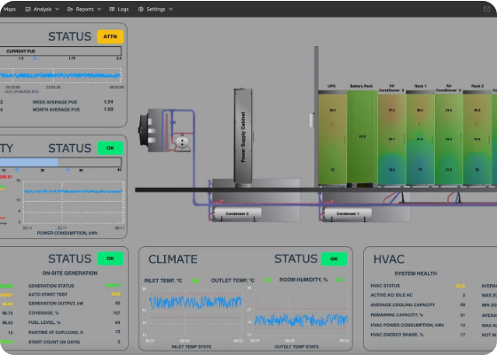
SYSTEM OVERVIEW
The Industrial Challenge
Standard SCADA systems rely on static thresholds, often missing the subtle "drift" of mechanical degradation. Our solution employs a "Belt and Suspenders" methodology.
•
Deterministic Layer: Statistical Z-Score overrides for sudden spikes.
•
Probabilistic Layer: Unsupervised Isolation Forest for multi-vector anomaly detection.
•
Prognostic Layer: Linear Regression for real-time RUL forecasting.

Slide 3





USE CASE ANALYSIS
UC-01: ML Training
UC-02: Evaluation
UC-03: RUL Predict
Initializes "Machine Memory" from SQLite history; fits Isolation Forest model on healthy operational data baseline.
Real-time ingestion of telemetry to assess machine state against unsupervised ML boundaries.
Activates supervised Linear Regression upon anomaly detection to project Remaining Useful Life based on degradation velocity.
Primary Actors: Sensor Module (System), Edge AI Node (System), Maintenance Engineer (Human).

Slide 4

HYBRID ANOMALY DETECTION
A. Isolation Forest
Identifies multi-vector outliers by isolating data points through decision trees. Anomalies require fewer splits.
B. Z-Score Override
Override Threshold: |Z| > 3.5
Parallel statistical math to catch rapid linear degradations and prevent "drift blindness."

Slide 5


RUL FORECASTING
Linear Regression Engine
Once a fault is latched (3-strike persistence), the system buffers the last 10 seconds of data.
The slope of the regression hyperplane determines the degradation velocity, providing a deterministic countdown to the NEMA/ISO safety limit.

Slide 6
FINITE STATE MACHINE (FSM)
State | Name | Logic & Trigger Condition
State 0 | Initialization | Boots MQTT, trains baselines, applies Poison Filter to SQLite history.
State 1 | Rest/Monitoring | Nominal operation. Consecutive anomaly counter is zero.
State 2 | Drift Identification | Unverified anomaly (Strike 1 or 2). System holds for confirmation.
State 3 | Stage 1 Warning | Latched alarm (Strike 3+). RUL Engine active. Digital Twin alerts.
State 4 | Stage 2 Critical | Hard Limit (e.g. >80°C) breached. Emergency Shutdown (ESD) issued.
State 5 | Repair Validation | Hysteresis logic: Requires 3 consecutive healthy readings to return to State 1.

Slide 7
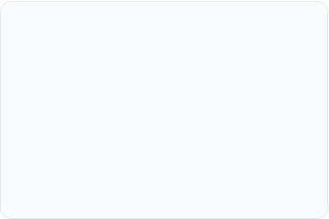


UML SEQUENCE INTERACTION
1. Perception
2. Intelligence
3. Presentation
Sensor Simulator publishes Raw Telemetry (JSON) to Mosquitto Broker at 1 Hz.
Edge AI Node parses payload, applies Smoothing, runs Hybrid Inference, and logs to SQLite.
Streamlit Dashboard polls SQLite asynchronously, renders Plotly charts and RUL countdown.
Latency Optimized: End-to-end processing < 15ms.

Slide 8

EDGE INFRASTRUCTURE
Target Environment
Optimized for ARM Cortex-A72 architectures (Raspberry Pi 4 / Jetson Nano).
•
Processor: Quad-core 1.5 GHz+ (supports twin inference engines).
•
Memory: 2 GB LPDDR4 minimum (efficient Python/Mosquitto footprint).
•
Storage: Localized SQLite for high-availability "Machine Memory."

Slide 9
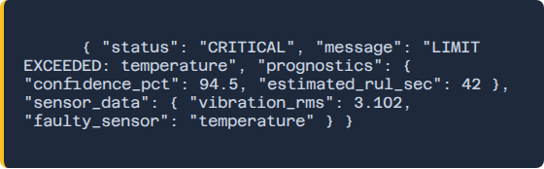
JSON MESSAGING SCHEMA
Diagnostic Payload
Upon fault identification, the system dynamically generates Root-Cause Analysis (RCA) metadata.
•
Status & Message tags.
•
Faulty Sensor ID.
•
Prognostic Confidence markers.

Slide 10






VALIDATION & PERFORMANCE
Unit Testing
Integration
Performance
Verified +1.0°C/sec slope detection and Gaussian noise filtering (< 2% variance).
Validated concurrent SQL read/write and 1 Hz MQTT throughput with zero database lockout.
Avg Latency: 8-15ms (Exceeding NFR-01 target of 50ms).

Slide 11
DEPLOYMENT MANUAL
1.
Environment: Run pip install -r requirements.txt to setup ML and MQTT frameworks.
2.
Connectivity: Start Mosquitto Broker on Port 1883.
3.
Simulation: Launch python cooling_pump_sim.py (1 Hz telemetry).
4.
Intelligence: Launch python edge_node.py (Isolation Forest / Z-Score).
5.
Digital Twin: Launch streamlit run dashboard.py for real-time visualization.
Master Command: python run_all.py

Slide 12
REFERENCES & CONCLUSION
[1] ISO 20816-1:2017 Mechanical vibration standards.
Questions?
[2] NEMA MG 1-2021: Motors and Generators guidelines.
[3] Liu et al. (2008) "Isolation Forest" IEEE ICDM.
Thank you for your attention.
[4] NIST SP 800-82 Revision 2: ICS Security.
Predictive Maintenance Project | CU_Project
[5] Si et al. (2011) "Remaining useful life estimation" EJOR.
github.com/smarthsalaria/predictive_maintenance

Slide 13




IMAGE SOURCES
https://www.cuchd.in/about/assets/images/cu-logo.png
Source: www.cuchd.in
https://centosoftware.com/wp-content/uploads/2025/11/1920-1000-CENTO-dashboard-DCIM.webp
Source: centosoftware.com
https://www1.edur.com/files/template/frontend/img/news/EDUR%20Centrifugal%20Pumps%20for%20Cooling%20Systems.png
Source: www1.edur.com
https://www.nvidia.com/content/nvidiaGDC/us/en_US/autonomous-machines/embedded-systems/jetson-nano/product-development/_jcr_content/root/responsivegrid/nv_container_1054256/nv_container_1666670587/nv_image.coreimg.100.1070.jpeg/1710770680654/jetson-partner-ecosystem-2560x1440.jpeg
Source: www.nvidia.com

